Slide 1
Python DP
TA
Python DP

Slide 2
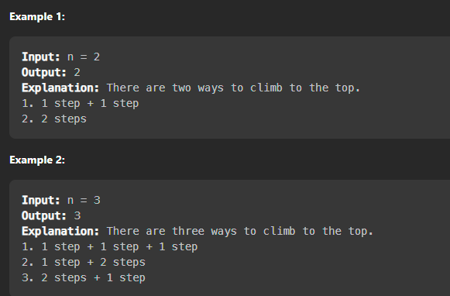
Practice 1 爬樓梯題目(leetcode 70)
假設我們需要爬一個樓梯，這個樓梯一共有 N 階，可以一步跨越 1 個或者 2 個台階，那麼爬完樓梯一共有多少種方式?
TA
Python DP

Slide 3

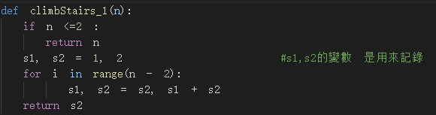
Practice 1 爬樓梯題目
爬第 n 階樓梯的方法數 =
「爬上 n−1 階樓梯的方法數量」 + 「爬上 n−2 階樓梯的方法數量」
F(n) = f(n-1) + f(n-2) 費式數列
結果 :
TA
Python DP

Slide 4
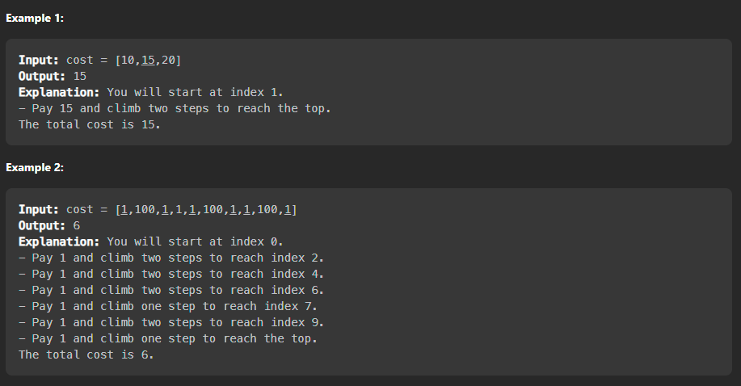
Practice 2 爬樓梯題目進階版(leetcode 746)
給你一個正整數的陣列，陣列內的值代表需要花費的cost，可以由index 0或index 1出發，一次走1或2步，問最少需要多少花費，才能走完整個陣列
TA
Python DP

Slide 5
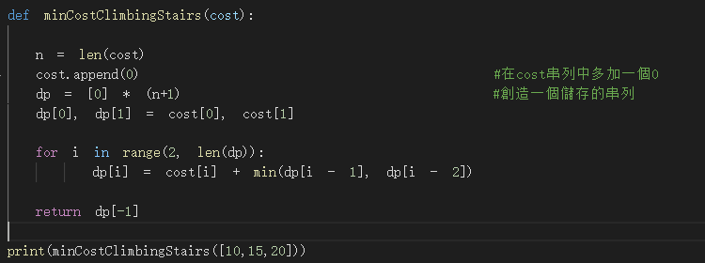

Practice 2 爬樓梯題目進階版(leetcode 746)
結果 :
TA
Python DP

Slide 6
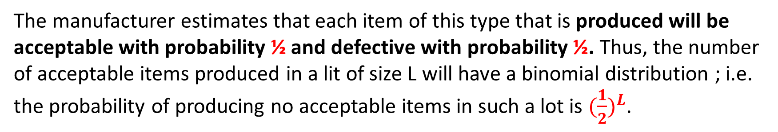
EXAMPLE1: DETERMINING REJECT ALLOWANCE
A company has received an order to supply one item of a particular type. However, the customer has specified such stringent quality requirements that the manufacturer may have to produce more than one item to obtain an item that is acceptable.
The number of extra items produced in a production run is called the reject allowance. Including a reject allowance is common practice when producing for a custom order, and it seems advisable in this case.
The manufacturer estimates that each item of this type that is produced will be acceptable with probability ½ and defective with probability ½. Thus, the number of acceptable items produced in a lit of size L will have a binomial distribution ; i.e. the probability of producing no acceptable items in such a lot is ${(\frac{1}{2})}^{L}$.
TA
Python DP

Slide 7
EXAMPLE1: DETERMINING REJECT ALLOWANCE
Marginal production costs for this product are estimated to be $100 per item (even if defective), and excess items are worthless. In addition, a setup cost of $300 must be incurred whenever the production process is set up for this product, and a completely new setup at this same cost is required for each subsequent production run if a lengthy inspection procedure reveals that a completed lot has not yielded an acceptable item.
The manufacturer has time to make no more than three production runs. If an acceptable item has not been obtained by the end of the third production run, the cost to the manufacturer in lost sales income and penalty costs will be $1,600.
The objective is to determine the policy regarding the lot size for the required production run(s) that minimizes total expected cost for the manufacturer.
TA
Python DP

Slide 8






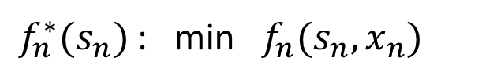




EXAMPLE1: DETERMINING REJECT ALLOWANCE
Stage n : production run n (n=1, 2, 3)
$X_{n}$ : lot size for stage n, $X_{n}=0, 1, 2, …∞$
$S_{n}$ : number of acceptable items still needed at beginning of stage n
$f_{n}(s_{n},x_{n})$ :
total expected cost for stage n onward, if system state is $s_{n}$, and decision is $x_{n}$
$f_{n}^{∗}(s_{n})$ : min $f_{n}(s_{n},x_{n})$
$$X_{n}=0, 1, 2,…$$
$$x_{1}$$
$$x_{2}$$
$$x_{3}$$
$$s_{1}$$
$$s_{2}$$
$$s_{3}$$
end
$$n=1$$
$$n=2$$
$$n=3$$
TA
Python DP

Slide 9
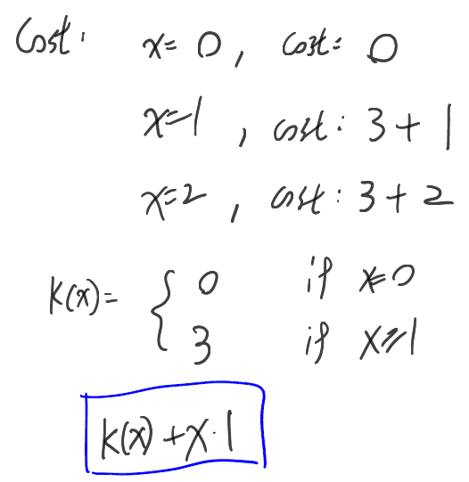
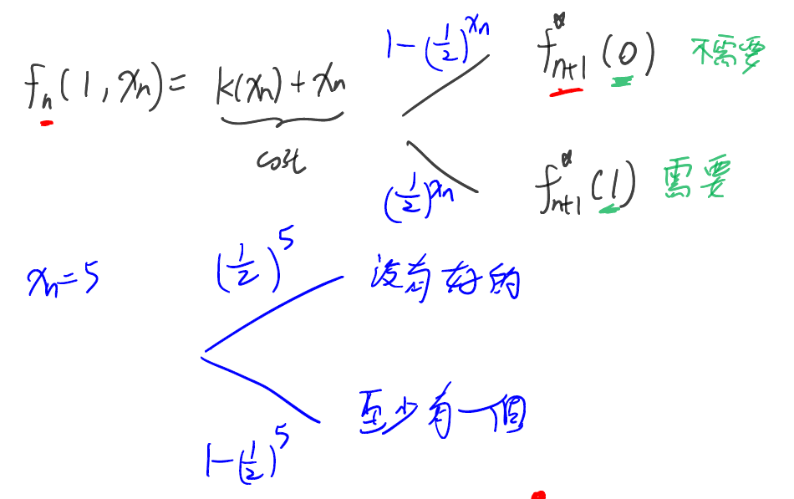
EXAMPLE1: DETERMINING REJECT ALLOWANCE
TA
Python DP

Slide 10
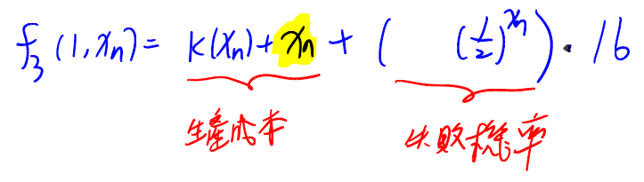
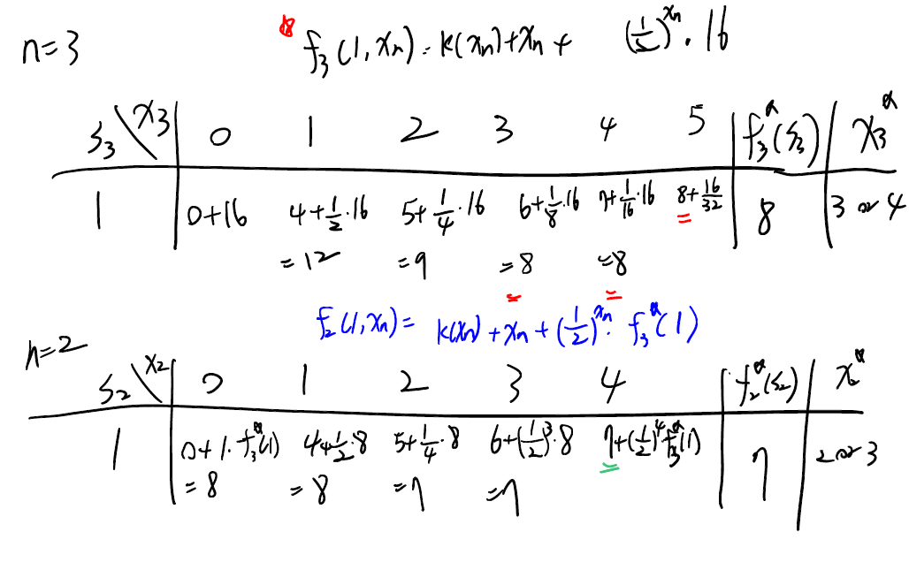
EXAMPLE1: DETERMINING REJECT ALLOWANCE
TA
Python DP

Slide 11
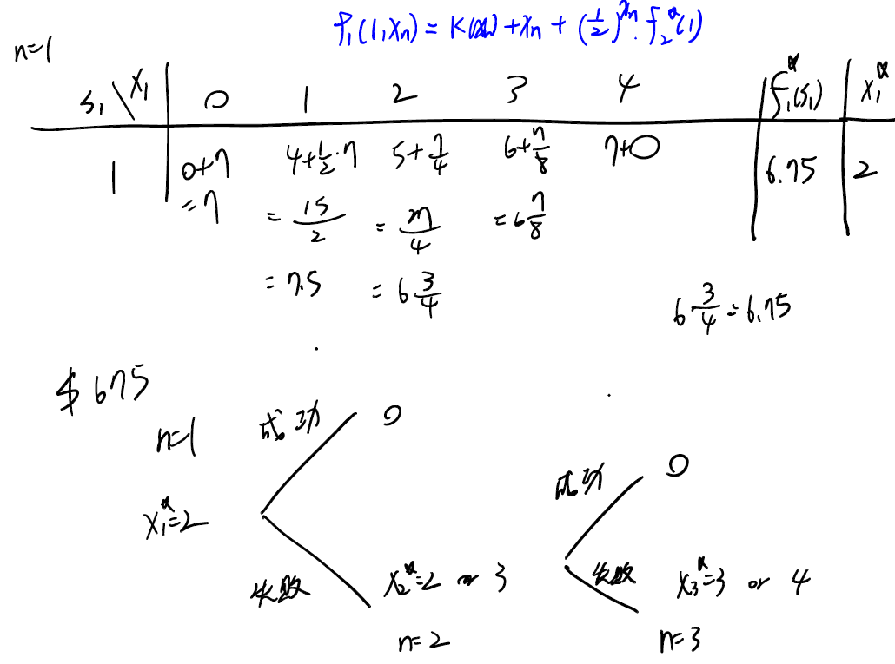
EXAMPLE1: DETERMINING REJECT ALLOWANCE
TA
Python DP

Slide 12
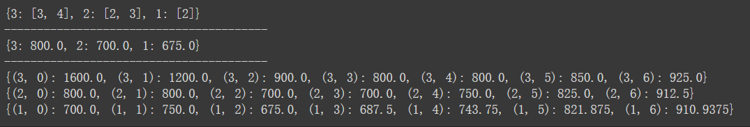
EXAMPLE1: DETERMINING REJECT ALLOWANCE
各期最佳決策
各期最佳解
各期各決策解
TA
Python DP

Slide 13
EXAMPLE1: DETERMINING REJECT ALLOWANCE
cSet = 300
cMar = 100
cPen = 1600
R = {} #裝各期的recursive，即該期最佳cost
S = {} #裝各期各x下的value
K = {} #裝各期最佳key值
X = 6 # 商品最大數量
T = 3 #總期數
for t in range(T, 0, -1): # 建立字典中的字典，每個小字典裝當期值
S[t] = {}
for t in range(T, 0, -1): # 執行backward induction
for x in range(0 , X+1): # 所有的生產量都嘗試看看
if t == T: # 如果現在是最後一期
if x == 0 :
reward = 0
else:
reward = cSet + x * cMar
value = reward + ((1/2)**x) * 1600
else: # 否則
if x == 0:
reward = 0
else:
reward = cSet + x * cMar
value = reward + ((1/2)**x) * R[t+1]
S[t][t, x] = value # 紀錄當下cost
minval = min(S[t].values()) #找出當期最小值
R[t] = minval # 當期最小的cost
for v in S[t]:
if S[t][v] == minval:
if t not in K:
K[t] = [v[1]] #第t期的最佳解是X=x
else:
K[t].append(v[1])
print(K)
print('----'*10)
print(R)
print('----'*10)
for i in S:
print(S[i])
TA
Python DP

Slide 14
cSet = 300
cMar = 100
cPen = 1600
R = {} #裝各期的recursive
S = {} #裝各期各x下的value
K = {} #裝各期最佳key值
X = 6 # 商品最大數量
T = 3 #總期數
for t in range(T, 0, -1): # 建立字典中的字典，每個小字典裝當期值
S[t] = {}
for t in range(T, 0, -1): # 執行backward induction
for x in range(0 , X+1): # 所有的生產量都嘗試看看
if t == T: # 如果現在是最後一期
if x == 0 :
reward = 0
else:
reward = cSet + x * cMar
value = reward + ((1/2)**x) * 1600
else: # 否則
if x == 0:
reward = 0
else:
reward = cSet + x * cMar
value = reward + ((1/2)**x) * R[t+1]
S[t][t, x] = value # 紀錄當下cost
minval = min(S[t].values()) #找出當期最小值
R[t] = minval # 當期最小的cost
for v in S[t]:
if S[t][v] == minval:
if t not in K:
K[t] = [v[1]] #第t期的最佳解是X=x
else:
K[t].append(v[1])
print(K)
print('----'*10)
print(R)
print('----'*10)
for i in S:
print(S[i])
EXAMPLE1: DETERMINING REJECT ALLOWANCE
TA
Python DP

Slide 15




EXAMPLE1: DETERMINING REJECT ALLOWANCE
cSet = 300
cMar = 100
cPen = 1600
R = {} #裝各期的recursive，即該期最佳cost
S = {} #裝各期各x下的value
K = {} #裝各期最佳key值
X = 6 # 商品最大數量
T = 3 #總期數
for t in range(T, 0, -1): # 建立字典中的字典，每個小字典裝當期值
S[t] = {}
基本參數設定
先想會有什麼dictionary要定義
所有決策下的value
各期最佳value
各期最佳value的決策
各期各決策可再增設小字典以方便分類與比較
TA
Python DP

Slide 16
EXAMPLE1: DETERMINING REJECT ALLOWANCE
for t in range(T, 0, -1): # 執行backward induction
for x in range(0 , X+1): # 所有的生產量都嘗試看看
if t == T: # 如果現在是最後一期
if x == 0 :
reward = 0
else:
reward = cSet + x * cMar
value = reward + ((1/2)**x) * 1600
else: # 否則
if x == 0:
reward = 0
else:
reward = cSet + x * cMar
value = reward + ((1/2)**x) * R[t+1]
S[t][t, x] = value # 紀錄當下cost
minval = min(S[t].values()) #找出當期最小值
R[t] = minval # 當期最小的cost
for v in S[t]:
if S[t][v] == minval:
if t not in K:
K[t] = [v[1]] #第t期的最佳解是X=x
else:
K[t].append(v[1])
建立動態規劃程式
由最後一期往前計算
T, T-1, …., 2, 1
因為T-1期value的計算會使用到T期的最佳成本，依此類推
使用for迴圈
注意：range(3, 0, -1)為[3, 2, 1]
此題目中，最後一期的value計算方式與其他期數不同
最後一期失敗需乘上懲罰性成本
其他期數失敗則乘以下期最佳成本
程式以if-else區隔成兩種計算
以min函數取第t期下的最小值
S字典存取所有決策的value
R字典存取最小value
K字典存取最小value的決策
註：可能出現多個決策皆會得出最小value
TA
Python DP

Slide 17
EXAMPLE1: DETERMINING REJECT ALLOWANCE
print(K)
print('----'*10)
print(R)
print('----'*10)
for i in S:
print(S[i])
把三個字典印出來 完成！
TA
Python DP

Slide 18
EXAMPLE2: WINNING IN LAS VEGAS
An enterprising young statistician believes that she has developed a system for winning a popular Las Vegas game. Her colleagues do not believe that her system works, so they have made a large bet with her that if she starts with three chips, she will not have at least five chips after three plays of the game.
Each play of the game involves betting any desired number of available chips and then either winning or losing this number of chips. The statistician believes that her system will give her a probability of 2/3 of winning a given play of the game.
Assuming the statistician is correct, we now use dynamic programming to determine her optimal policy regarding how many chips to bet at each of the three plays of the game.
The decision at each play should take into account the results of earlier plays. The objective is to maximize the probability of winning her bet with her colleagues.
TA
Python DP

Slide 19

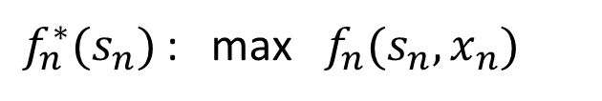
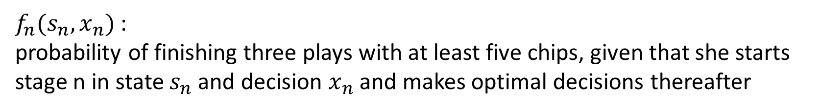
EXAMPLE2: WINNING IN LAS VEGAS
Stage n : nth number of game (n=1, 2, 3)
$X_{n}$ : number of chips to bet at stage n
$S_{n}$ : number of chips in hand to begin state n
$f_{n}(s_{n},x_{n})$ :
probability of finishing three plays with at least five chips, given that she starts stage n in state $s_{n}$and decision $x_{n}$ and makes optimal decisions thereafter
$f_{n}^{∗}(s_{n})$ : max $f_{n}(s_{n},x_{n})$
$$X_{n}=0, …,S_{n}$$
$$x_{1}$$
$$x_{2}$$
$$x_{3}$$
$$s_{1}$$
$$s_{2}$$
$$s_{3}$$
end
$$n=1$$
$$n=2$$
$$n=3$$
TA
Python DP

Slide 20
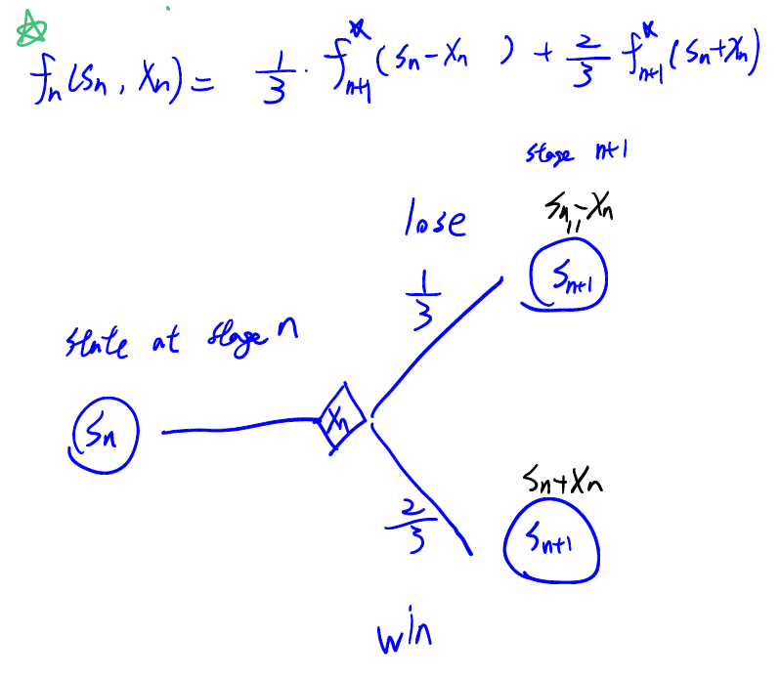
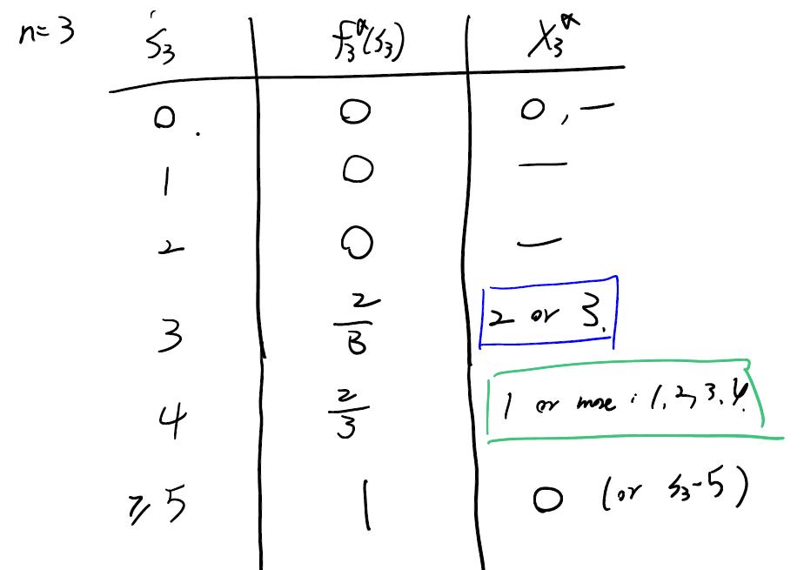
EXAMPLE2: WINNING IN LAS VEGAS
前兩期
TA
Python DP

Slide 21
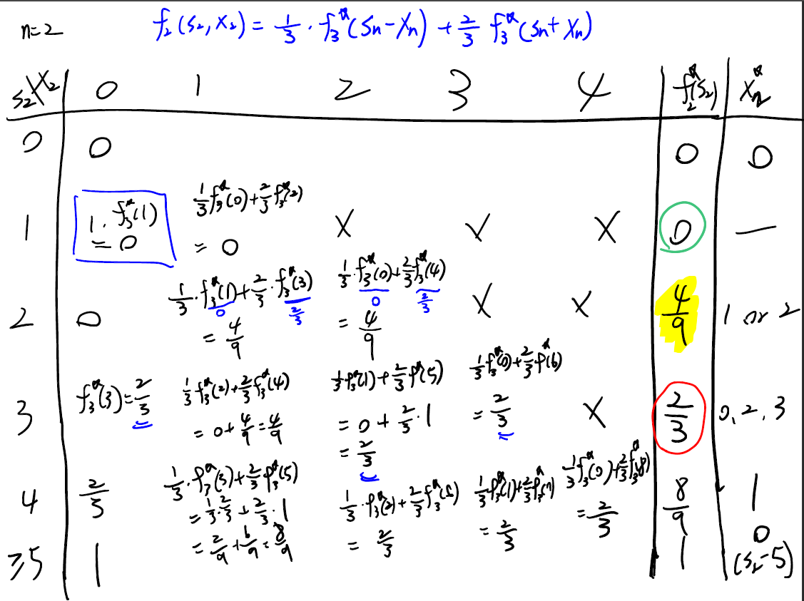
EXAMPLE2: WINNING IN LAS VEGAS
TA
Python DP

Slide 22
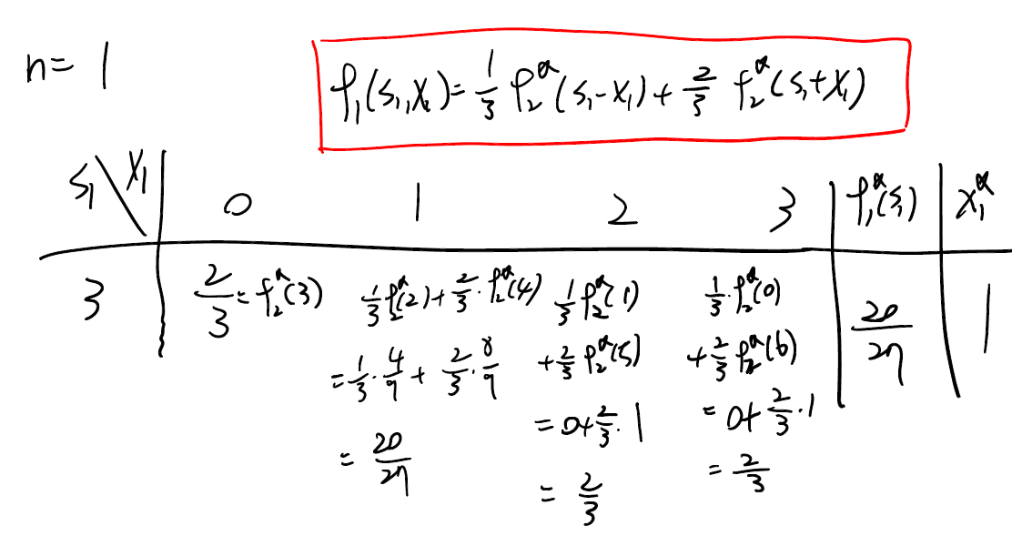
EXAMPLE2: WINNING IN LAS VEGAS
TA
Python DP

Slide 23
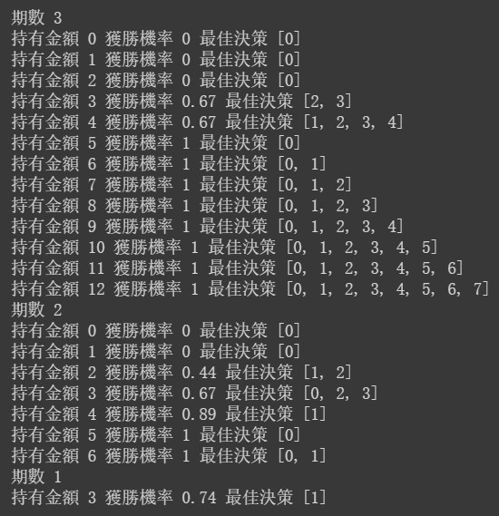
EXAMPLE2: WINNING IN LAS VEGAS
TA
Python DP

Slide 24
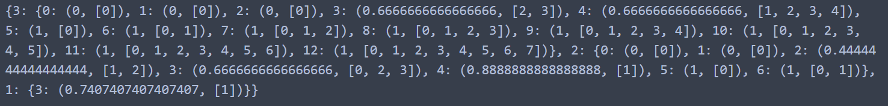
EXAMPLE2: WINNING IN LAS VEGAS
TA
Python DP

Slide 25
EXAMPLE2: WINNING IN LAS VEGAS
import numpy as np #最後四捨五入需要用到的套件
init_money = 3 #起始金額
T = 3 #總期數
max_money_on_hand = [0]
for i in range(0,T):
max_money_on_hand.append(init_money * (2**(i)))
#print(max_money_on_hand)
O = {} #裝各期各初始金額下最佳決策
money_prob = {} #裝各期各金額各決策下的解 (未含必輸必贏以及最後一期)
for t in range(T,0,-1):
max_money = max_money_on_hand[t]
O[t] = {} #重要，在O的字典裡插入字典，每一期為一個小字典
if t == T: #最後一期
for money in range(0, max_money+1):
if 2*money < 5: #all in 還必輸
O[t][money] = (0, [0]) #(最佳機率、最佳決策)
elif money >= 5: #穩贏
best_action = []
for i in range(0, money - 5 + 1): #不能出完錢口袋剩不到五塊
best_action.append(i)
O[t][money] = (1, best_action)
else:
best_action = []
for i in range(5-money, money + 1): #如果贏了至少贏後要有五塊
best_action.append(i)
O[t][money] = (2/3, best_action)
#print(O[3])
elif t != 1: #不會包含最後一期因為if elif的順序
money_prob[t] = {}
for money in range(0, max_money+1):
if money * (2**(T-t+1)) < 5: #二的剩餘期數加一次方 #每期all in但最終必輸
O[t][money] = (0, [0])
elif money >= 5: #穩贏
best_action = []
for i in range(0, money - 5 + 1):
best_action.append(i)
O[t][money] = (1, best_action)
else: #其他
money_prob[t][money] = {}
max_prob = -1 #最小值亂設比零小就好
for i in range(0 , money + 1):
temp_prob = 1/3 * O[t+1][money-i][0] + 2/3 * O[t+1][money+i][0] #記得補0
money_prob[t][money][i] = temp_prob #第t期手上有money元做了i決策
if temp_prob > max_prob:
max_prob = temp_prob
best_action = [i]
elif temp_prob == max_prob:
best_action.append(i)
#print(max_prob, best_action)
#print(money_prob)
O[t][money] = (max_prob, best_action) #第t期手上有money元最佳機率為maxprob最佳決策為bestaction
#print(O[2])
elif t == 1: #第1期
money_prob[1] = {} #在money_prob字典中又建了第一期(key值為1)的小字典
money_prob[1][3] = {} #在第一期的小字典中又建了手上有三塊(key值為3)的小字典
max_prob = -1
for i in range(0, max_money+1): #0, 1, 2, 3
temp_prob = 1/3 * O[t+1][3-i][0] + 2/3 * O[t+1][3+i][0]
money_prob[1][3][i] = temp_prob
if temp_prob > max_prob:
max_prob = temp_prob
best_action = [i]
elif temp_prob == max_prob:
best_action.append(i)
O[t][3] =(max_prob, best_action)
#print(O[1])
print(money_prob)
print()
print(O)
print()
for i in money_prob:
print('期數',i)
for j in money_prob[i]:
print('持有金額',j)
for k in money_prob[i][j]:
print('付出金額',k,'獲勝機率:',money_prob[i][j][k])
print()
for i in O:
print("期數", i)
for j in O[i]:
print("持有金額", j, "獲勝機率", np.round(O[i][j][0],2), "最佳決策", O[i][j][1])
TA
Python DP

Slide 26
import numpy as np #最後四捨五入需要用到的套件
init_money = 3 #起始金額
T = 3 #總期數
max_money_on_hand = [0]
for i in range(0,T):
max_money_on_hand.append(init_money * (2**(i)))
#print(max_money_on_hand)
O = {} #裝各期各初始金額下最佳決策
money_prob = {} #裝各期各金額各決策下的解 (未含必輸必贏以及最後一期)
for t in range(T,0,-1):
max_money = max_money_on_hand[t]
O[t] = {} #重要，在O的字典裡插入字典，每一期為一個小字典
if t == T: #最後一期
for money in range(0, max_money+1):
if 2*money < 5: #all in 還必輸
O[t][money] = (0, [0]) #(最佳機率、最佳決策)
elif money >= 5: #穩贏
best_action = []
for i in range(0, money - 5 + 1): #不能出完錢口袋剩不到五塊
best_action.append(i)
O[t][money] = (1, best_action)
else:
best_action = []
for i in range(5-money, money + 1): #如果贏了至少贏後要有五塊
best_action.append(i)
O[t][money] = (2/3, best_action)
#print(O[3])
elif t != 1: #不會包含最後一期因為if elif的順序
money_prob[t] = {}
for money in range(0, max_money+1):
if money * (2**(T-t+1)) < 5: #二的剩餘期數加一次方 #每期all in但最終必輸
O[t][money] = (0, [0])
elif money >= 5: #穩贏
best_action = []
for i in range(0, money - 5 + 1):
best_action.append(i)
O[t][money] = (1, best_action)
else: #其他
money_prob[t][money] = {}
max_prob = -1 #最小值亂設比零小就好
for i in range(0 , money + 1):
temp_prob = 1/3 * O[t+1][money-i][0] + 2/3 * O[t+1][money+i][0] #記得補0
money_prob[t][money][i] = temp_prob #第t期手上有money元做了i決策
if temp_prob > max_prob:
max_prob = temp_prob
best_action = [i]
elif temp_prob == max_prob:
best_action.append(i)
#print(max_prob, best_action)
#print(money_prob)
O[t][money] = (max_prob, best_action) #第t期手上有money元最佳機率為maxprob最佳決策為bestaction
#print(O[2])
elif t == 1: #第1期
money_prob[1] = {} #在money_prob字典中又建了第一期(key值為1)的小字典
money_prob[1][3] = {} #在第一期的小字典中又建了手上有三塊(key值為3)的小字典
max_prob = -1
for i in range(0, max_money+1): #0, 1, 2, 3
temp_prob = 1/3 * O[t+1][3-i][0] + 2/3 * O[t+1][3+i][0]
money_prob[1][3][i] = temp_prob
if temp_prob > max_prob:
max_prob = temp_prob
best_action = [i]
elif temp_prob == max_prob:
best_action.append(i)
O[t][3] =(max_prob, best_action)
#print(O[1])
print(money_prob)
print()
print(O)
print()
for i in money_prob:
print('期數',i)
for j in money_prob[i]:
print('持有金額',j)
for k in money_prob[i][j]:
print('付出金額',k,'獲勝機率:',money_prob[i][j][k])
print()
for i in O:
print("期數", i)
for j in O[i]:
print("持有金額", j, "獲勝機率", np.round(O[i][j][0],2), "最佳決策", O[i][j][1])
EXAMPLE2: WINNING IN LAS VEGAS
TA
Python DP

Slide 27
import numpy as np #最後四捨五入需要用到的套件
init_money = 3 #起始金額
T = 3 #總期數
max_money_on_hand = [0]
for i in range(0,T):
max_money_on_hand.append(init_money * (2**(i)))
#print(max_money_on_hand)
O = {} #裝各期各初始金額下最佳決策
money_prob = {} #裝各期各金額各決策下的解 (未含必輸必贏以及最後一期)
for t in range(T,0,-1):
max_money = max_money_on_hand[t]
O[t] = {} #重要，在O的字典裡插入字典，每一期為一個小字典
if t == T: #最後一期
for money in range(0, max_money+1):
if 2*money < 5: #all in 還必輸
O[t][money] = (0, [0]) #(最佳機率、最佳決策)
elif money >= 5: #穩贏
best_action = []
for i in range(0, money - 5 + 1): #不能出完錢口袋剩不到五塊
best_action.append(i)
O[t][money] = (1, best_action)
else:
best_action = []
for i in range(5-money, money + 1): #如果贏了至少贏後要有五塊
best_action.append(i)
O[t][money] = (2/3, best_action)
#print(O[3])
elif t != 1: #不會包含最後一期因為if elif的順序
money_prob[t] = {}
for money in range(0, max_money+1):
if money * (2**(T-t+1)) < 5: #二的剩餘期數加一次方 #每期all in但最終必輸
O[t][money] = (0, [0])
elif money >= 5: #穩贏
best_action = []
for i in range(0, money - 5 + 1):
best_action.append(i)
O[t][money] = (1, best_action)
else: #其他
money_prob[t][money] = {}
max_prob = -1 #最小值亂設比零小就好
for i in range(0 , money + 1):
temp_prob = 1/3 * O[t+1][money-i][0] + 2/3 * O[t+1][money+i][0] #記得補0
money_prob[t][money][i] = temp_prob #第t期手上有money元做了i決策
if temp_prob > max_prob:
max_prob = temp_prob
best_action = [i]
elif temp_prob == max_prob:
best_action.append(i)
#print(max_prob, best_action)
#print(money_prob)
O[t][money] = (max_prob, best_action) #第t期手上有money元最佳機率為maxprob最佳決策為bestaction
#print(O[2])
elif t == 1: #第1期
money_prob[1] = {} #在money_prob字典中又建了第一期(key值為1)的小字典
money_prob[1][3] = {} #在第一期的小字典中又建了手上有三塊(key值為3)的小字典
max_prob = -1
for i in range(0, max_money+1): #0, 1, 2, 3
temp_prob = 1/3 * O[t+1][3-i][0] + 2/3 * O[t+1][3+i][0]
money_prob[1][3][i] = temp_prob
if temp_prob > max_prob:
max_prob = temp_prob
best_action = [i]
elif temp_prob == max_prob:
best_action.append(i)
O[t][3] =(max_prob, best_action)
#print(O[1])
print(money_prob)
print()
print(O)
print()
for i in money_prob:
print('期數',i)
for j in money_prob[i]:
print('持有金額',j)
for k in money_prob[i][j]:
print('付出金額',k,'獲勝機率:',money_prob[i][j][k])
print()
for i in O:
print("期數", i)
for j in O[i]:
print("持有金額", j, "獲勝機率", np.round(O[i][j][0],2), "最佳決策", O[i][j][1])
EXAMPLE2: WINNING IN LAS VEGAS
TA
Python DP

Slide 28
import numpy as np #最後四捨五入需要用到的套件
init_money = 3 #起始金額
T = 3 #總期數
max_money_on_hand = [0]
for i in range(0,T):
max_money_on_hand.append(init_money * (2**(i)))
#print(max_money_on_hand)
O = {} #裝各期各初始金額下最佳決策
money_prob = {} #裝各期各金額各決策下的解 (未含必輸必贏以及最後一期)
for t in range(T,0,-1):
max_money = max_money_on_hand[t]
O[t] = {} #重要，在O的字典裡插入字典，每一期為一個小字典
if t == T: #最後一期
for money in range(0, max_money+1):
if 2*money < 5: #all in 還必輸
O[t][money] = (0, [0]) #(最佳機率、最佳決策)
elif money >= 5: #穩贏
best_action = []
for i in range(0, money - 5 + 1): #不能出完錢口袋剩不到五塊
best_action.append(i)
O[t][money] = (1, best_action)
else:
best_action = []
for i in range(5-money, money + 1): #如果贏了至少贏後要有五塊
best_action.append(i)
O[t][money] = (2/3, best_action)
#print(O[3])
elif t != 1: #不會包含最後一期因為if elif的順序
money_prob[t] = {}
for money in range(0, max_money+1):
if money * (2**(T-t+1)) < 5: #二的剩餘期數加一次方 #每期all in但最終必輸
O[t][money] = (0, [0])
elif money >= 5: #穩贏
best_action = []
for i in range(0, money - 5 + 1):
best_action.append(i)
O[t][money] = (1, best_action)
else: #其他
money_prob[t][money] = {}
max_prob = -1 #最小值亂設比零小就好
for i in range(0 , money + 1):
temp_prob = 1/3 * O[t+1][money-i][0] + 2/3 * O[t+1][money+i][0] #記得補0
money_prob[t][money][i] = temp_prob #第t期手上有money元做了i決策
if temp_prob > max_prob:
max_prob = temp_prob
best_action = [i]
elif temp_prob == max_prob:
best_action.append(i)
#print(max_prob, best_action)
#print(money_prob)
O[t][money] = (max_prob, best_action) #第t期手上有money元最佳機率為maxprob最佳決策為bestaction
#print(O[2])
elif t == 1: #第1期
money_prob[1] = {} #在money_prob字典中又建了第一期(key值為1)的小字典
money_prob[1][3] = {} #在第一期的小字典中又建了手上有三塊(key值為3)的小字典
max_prob = -1
for i in range(0, max_money+1): #0, 1, 2, 3
temp_prob = 1/3 * O[t+1][3-i][0] + 2/3 * O[t+1][3+i][0]
money_prob[1][3][i] = temp_prob
if temp_prob > max_prob:
max_prob = temp_prob
best_action = [i]
elif temp_prob == max_prob:
best_action.append(i)
O[t][3] =(max_prob, best_action)
#print(O[1])
print(money_prob)
print()
print(O)
print()
for i in money_prob:
print('期數',i)
for j in money_prob[i]:
print('持有金額',j)
for k in money_prob[i][j]:
print('付出金額',k,'獲勝機率:',money_prob[i][j][k])
print()
for i in O:
print("期數", i)
for j in O[i]:
print("持有金額", j, "獲勝機率", np.round(O[i][j][0],2), "最佳決策", O[i][j][1])
EXAMPLE2: WINNING IN LAS VEGAS
TA
Python DP

Slide 29
import numpy as np #最後四捨五入需要用到的套件
init_money = 3 #起始金額
T = 3 #總期數
max_money_on_hand = [0]
for i in range(0,T):
max_money_on_hand.append(init_money * (2**(i)))
#print(max_money_on_hand)
O = {} #裝各期各初始金額下最佳決策
money_prob = {} #裝各期各金額各決策下的解 (未含必輸必贏以及最後一期)
for t in range(T,0,-1):
max_money = max_money_on_hand[t]
O[t] = {} #重要，在O的字典裡插入字典，每一期為一個小字典
if t == T: #最後一期
for money in range(0, max_money+1):
if 2*money < 5: #all in 還必輸
O[t][money] = (0, [0]) #(最佳機率、最佳決策)
elif money >= 5: #穩贏
best_action = []
for i in range(0, money - 5 + 1): #不能出完錢口袋剩不到五塊
best_action.append(i)
O[t][money] = (1, best_action)
else:
best_action = []
for i in range(5-money, money + 1): #如果贏了至少贏後要有五塊
best_action.append(i)
O[t][money] = (2/3, best_action)
#print(O[3])
elif t != 1: #不會包含最後一期因為if elif的順序
money_prob[t] = {}
for money in range(0, max_money+1):
if money * (2**(T-t+1)) < 5: #二的剩餘期數加一次方 #每期all in但最終必輸
O[t][money] = (0, [0])
elif money >= 5: #穩贏
best_action = []
for i in range(0, money - 5 + 1):
best_action.append(i)
O[t][money] = (1, best_action)
else: #其他
money_prob[t][money] = {}
max_prob = -1 #最小值亂設比零小就好
for i in range(0 , money + 1):
temp_prob = 1/3 * O[t+1][money-i][0] + 2/3 * O[t+1][money+i][0] #記得補0
money_prob[t][money][i] = temp_prob #第t期手上有money元做了i決策
if temp_prob > max_prob:
max_prob = temp_prob
best_action = [i]
elif temp_prob == max_prob:
best_action.append(i)
#print(max_prob, best_action)
#print(money_prob)
O[t][money] = (max_prob, best_action) #第t期手上有money元最佳機率為maxprob最佳決策為bestaction
#print(O[2])
elif t == 1: #第1期
money_prob[1] = {} #在money_prob字典中又建了第一期(key值為1)的小字典
money_prob[1][3] = {} #在第一期的小字典中又建了手上有三塊(key值為3)的小字典
max_prob = -1
for i in range(0, max_money+1): #0, 1, 2, 3
temp_prob = 1/3 * O[t+1][3-i][0] + 2/3 * O[t+1][3+i][0]
money_prob[1][3][i] = temp_prob
if temp_prob > max_prob:
max_prob = temp_prob
best_action = [i]
elif temp_prob == max_prob:
best_action.append(i)
O[t][3] =(max_prob, best_action)
#print(O[1])
print(money_prob)
print()
print(O)
print()
for i in money_prob:
print('期數',i)
for j in money_prob[i]:
print('持有金額',j)
for k in money_prob[i][j]:
print('付出金額',k,'獲勝機率:',money_prob[i][j][k])
print()
for i in O:
print("期數", i)
for j in O[i]:
print("持有金額", j, "獲勝機率", np.round(O[i][j][0],2), "最佳決策", O[i][j][1])
EXAMPLE2: WINNING IN LAS VEGAS
TA
Python DP

Slide 30

EXAMPLE2: WINNING IN LAS VEGAS
np四捨五入於結尾印出再操作，不然中途計算有誤差
import numpy as np #最後四捨五入需要用到的套件
init_money = 3 #起始金額
T = 3 #總期數
max_money_on_hand = [0]
for i in range(0,T):
max_money_on_hand.append(init_money * (2**(i)))
#print(max_money_on_hand)
O = {} #裝各期各初始金額下最佳決策
money_prob = {} #裝各期各金額各決策下的解 (未含必輸必贏以及最後一期)
for t in range(T,0,-1):
max_money = max_money_on_hand[t]
O[t] = {} #重要，在O的字典裡插入字典，每一期為一個小字典
基本參數設定
找出各期所有可能性
理由：當期遞迴成本需從下期找
起始金額為3，第一期all in 勝則第二期起始金額為6
繼續，第二期all in 勝，則第三期起始金額為12，依此類推
設置字典
各期各狀態下最佳決策與最佳解
各期各狀態各決策的解
TA
Python DP

Slide 31
EXAMPLE2: WINNING IN LAS VEGAS
if t == T: #最後一期
for money in range(0, max_money+1):
if 2*money < 5: #all in 還必輸
O[t][money] = (0, [0]) #(最佳機率、最佳決策)
elif money >= 5: #穩贏
best_action = []
for i in range(0, money - 5 + 1): #不能出完錢口袋剩不到五塊
best_action.append(i)
O[t][money] = (1, best_action)
else:
best_action = []
for i in range(5-money, money + 1): #如果贏了至少贏後要有五塊
best_action.append(i)
O[t][money] = (2/3, best_action)
#print(O[3])
最後一期：三種情境
穩輸(0)、穩贏(1)、有機會贏(2/3)
TA
Python DP

Slide 32
EXAMPLE2: WINNING IN LAS VEGAS
elif t != 1: #不會包含最後一期因為if elif的順序
money_prob[t] = {}
for money in range(0, max_money+1): #0,1,2,3,4,5,6
if money * (2**(T-t+1)) < 5: #二的剩餘期數加一次方 #每期all in但最終必輸
O[t][money] = (0, [0])
elif money >= 5: #穩贏
best_action = []
for i in range(0, money - 5 + 1):
best_action.append(i)
O[t][money] = (1, best_action)
else: #其他
money_prob[t][money] = {}
max_prob = -1 #最小值亂設比零小就好
for i in range(0 , money + 1):
temp_prob = 1/3 * O[t+1][money-i][0] + 2/3 * O[t+1][money+i][0] #記得補0
money_prob[t][money][i] = temp_prob #第t期手上有money元做了i決策
if temp_prob > max_prob:
max_prob = temp_prob
best_action = [i]
elif temp_prob == max_prob:
best_action.append(i)
#print(max_prob, best_action)
#print(money_prob)
O[t][money] = (max_prob, best_action) #第t期手上有money元最佳機率為maxprob最佳決策為bestaction
#print(O[2])
第二期：同樣三種情境
O裝第t期下，起始金額money的最佳機率max_prob與最佳解best_action
Money_prob裝非必贏必輸情境下，各起始金額money下各決策的值
TA
Python DP

Slide 33

EXAMPLE2: WINNING IN LAS VEGAS
elif t == 1: #第1期
money_prob[1] = {} #在money_prob字典中又建了第一期(key值為1)的小字典
money_prob[1][3] = {} #在第一期的小字典中又建了手上有三塊(key值為3)的小字典
max_prob = -1
for i in range(0, max_money+1): #0, 1, 2, 3
temp_prob = 1/3 * O[t+1][3-i][0] + 2/3 * O[t+1][3+i][0]
money_prob[1][3][i] = temp_prob
if temp_prob > max_prob:
max_prob = temp_prob
best_action = [i]
elif temp_prob == max_prob:
best_action.append(i)
O[t][3] =(max_prob, best_action)
#print(O[1])
第一期：初始金額為3
於money_prob建立第一期初始金額為3的小小字典
最佳解帶入O字典
TA
Python DP

Slide 34
EXAMPLE2: WINNING IN LAS VEGAS
print(money_prob)
print()
print(O)
print()
for i in money_prob:
print('期數',i)
for j in money_prob[i]:
print('持有金額',j)
for k in money_prob[i][j]:
print('付出金額',k,'獲勝機率:',money_prob[i][j][k])
print()
for i in O:
print("期數", i)
for j in O[i]:
print("持有金額", j, "獲勝機率", np.round(O[i][j][0],2), "最佳決策", O[i][j][1])
印出所有內容(於下頁)
TA
Python DP

Slide 35
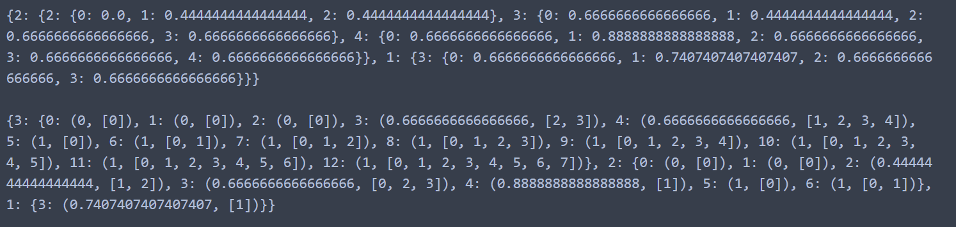
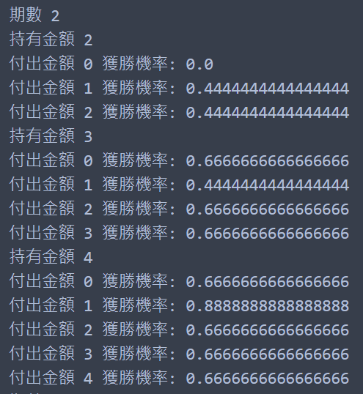
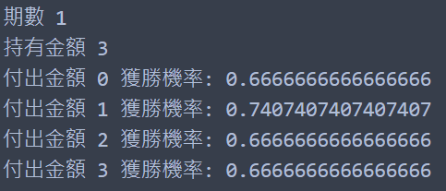
EXAMPLE2: WINNING IN LAS VEGAS
money_prob字典
O字典
money_prob字典
TA
Python DP

Slide 36
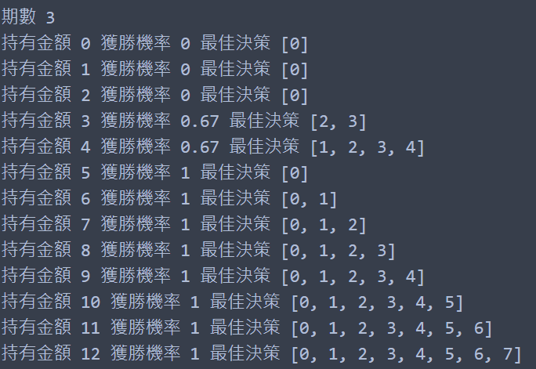
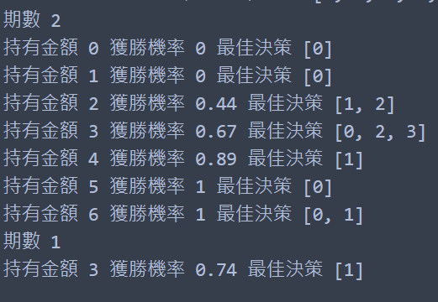
EXAMPLE2: WINNING IN LAS VEGAS
O字典
TA
Python DP

